Slide 1

React Session 0
Basic syntax
Code Mentor Mauritius - React Sessions – Full Stack Web Development

Slide 2

JSX (JavaScript XML)
JSX
a syntax extension for JavaScript often used in React.
allows you to write HTML-like code in JavaScript.
Code Mentor Mauritius - React Sessions – Full Stack Web Development

Slide 3
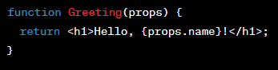
Functional Components for reusable UI elements.
We define a functional component called Greeting.
Inside the Greeting component,
The component renders a greeting message
We render the Greeting component by calling ReactDOM.render(),
Functional components are simple, reusable functions that take props as their input and return JSX to render content.
we use props.name to access the "name" prop value.
that includes the "name" prop value.
passing the "name" prop with the value “John" as an attribute.
Code Mentor Mauritius - React Sessions – Full Stack Web Development

Slide 4
Creating React Elements
ReactDOM.render()
render React elements to the DOM.
The first argument is the React component to render
The second argument is the target DOM element
React processes the component, converts its JSX into HTML,
where the rendered component will appear. It's identified by an ID,
displays it in the specified DOM element,
showing "Welcome, Alice!" on the web page.
which should exist in your HTML document.
Code Mentor Mauritius - React Sessions – Full Stack Web Development

Slide 5
Props (short for properties)
pass data from parent components
tochild components
using props.
Code Mentor Mauritius - React Sessions – Full Stack Web Development

Slide 6
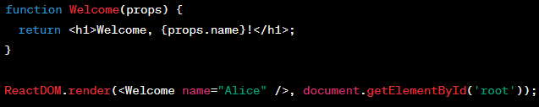
Props (short for properties) Example
We create a Welcome component
Inside the Welcome component,
The component renders a message
When rendered, we pass the "name" prop with the value "Alice"
that takes a props parameter, which holds data passed to the component.
we use props.name to access the "name" prop value.
that includes the "name" prop value.
using ReactDOM.render(), resulting in the message "Welcome, Alice!" being displayed.
Code Mentor Mauritius - React Sessions – Full Stack Web Development

Slide 7
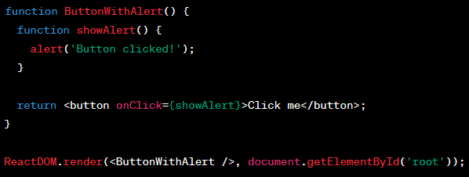
Event Handling
onClick
Code Mentor Mauritius - React Sessions – Full Stack Web Development

Slide 8
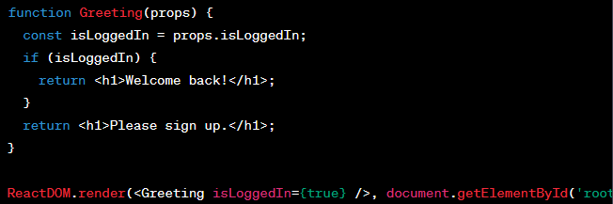
Conditional Rendering
conditionally render content based on certain conditions using JavaScript expressions.
Code Mentor Mauritius - React Sessions – Full Stack Web Development

Slide 9
Lists and Keys
map over arrays to render lists in React.
Code Mentor Mauritius - React Sessions – Full Stack Web Development

Slide 10
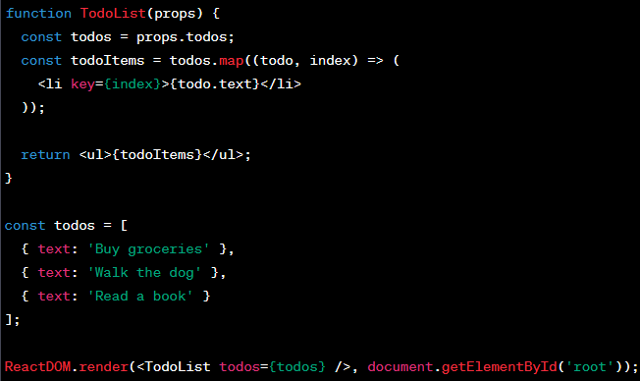
Lists and Keys
The TodoList component receives a list of to-do items (props.todos) as a prop.
The to-do items' text is displayed
It uses the .map() method to create a list of <li>
Finally, we render the TodoList component
elements for each to-do item, assigning a unique key based on the item's index.
within each list item, and the list is wrapped in a <ul> element.
The todos array contains three to-do items.
with the to-do items within the DOM element with the ID "root."
Code Mentor Mauritius - React Sessions – Full Stack Web Development

Slide 11
Styling in React
inline styles,
CSS modules,
external libraries like Styled Components.
Code Mentor Mauritius - React Sessions – Full Stack Web Development

Slide 12
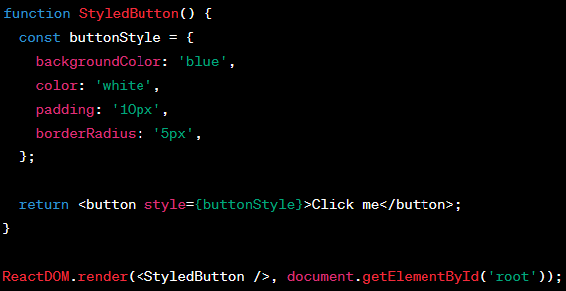
Styling in React
The StyledButton functional component defines a set of inline styles
We use JSX to render a button element
The StyledButton component is rendered into the DOM
for a button using a JavaScript object called buttonStyle.
and apply the styles using the style attribute with the buttonStyle object.
element with the ID "root."
Code Mentor Mauritius - React Sessions – Full Stack Web Development

Slide 13
Hooks (for Functional Components)
useState
useEffect
Code Mentor Mauritius - React Sessions – Full Stack Web Development

Slide 14
useEffect hook
Import {useEffect} from ‘react’;
Syntax: useEffect(()=>{console.log(‘page loaded’)})
Allows us to do something when an event happens
useEffect(()=>{console.log(‘page loaded’)}, [])
Dependency array, if left as empty array, useEffect is only called at the start
Code Mentor Mauritius - React Sessions – Full Stack Web Development

